Slide 1
Engaging the 21st Century Learner
Classroom Connections & Technology

Slide 2
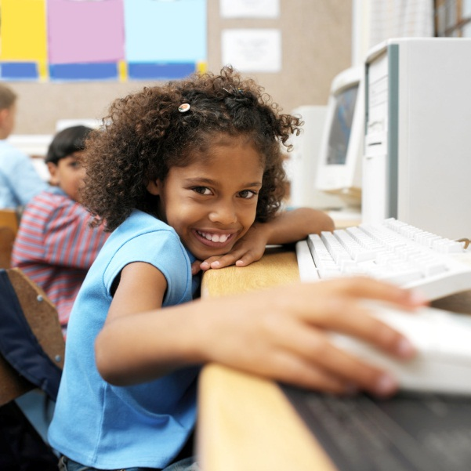
Enhance Learning
Students today are more connected than ever. Why shouldn’t we use these connections to enhance classroom learning experiences?

Slide 3
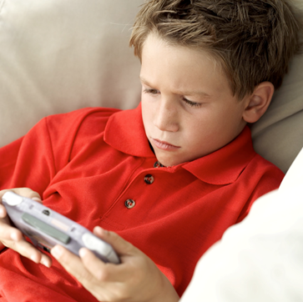
How are students connected?
21st century learners use technology and the internet to make connections. Computers, tablets, e-readers, smart phones, and video game consoles are avenues for information and social networking.

Slide 4
How does the internet help make classroom connections?
According to a research study performed by the Pew Internet & American Life Project, “94% of youth ages 12 – 17 who have internet access say they use the internet for school research and 78% say they believe the internet helps them with schoolwork” (Lenhart 2001, p.2).

Slide 5
Can social networking be used as a tool in school?
Social networking goes beyond Facebook and MySpace. Discussion boards, blogs, podcasts, chat rooms, forums, and Twitter are all types of social networking that can be used in the classroom. Using Twitter, “teachers can give students the power to discuss a topic, ask and answer questions, post links to useful sources, and comment on those sources” (Matteson 2010, p.22).

Slide 6
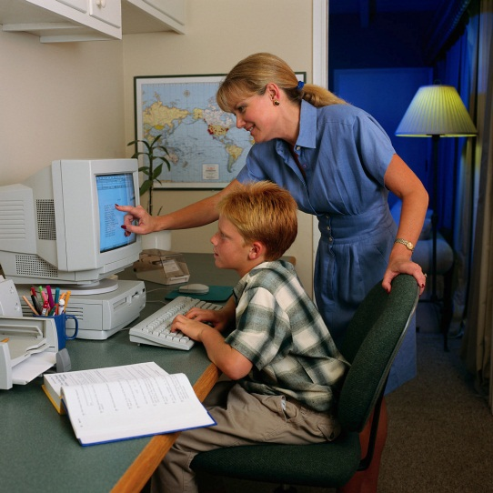
Do students want the connections?
YES! Providing those connections for students can help them to be more successful students and become lifelong learners. In a study, “58% of online teens report using web sites that had been set up specifically for their school or for a particular class” (Lenhart 2001, p.2).

Slide 7
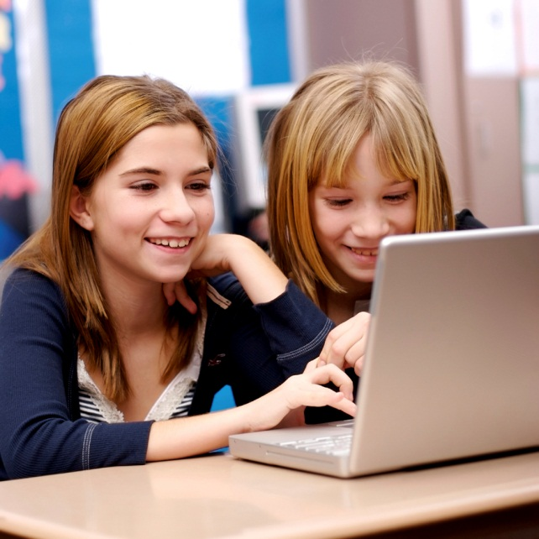
If you create the environment, they will be engaged!
Educators are responsible for understanding the diverse needs of their students. Utilizing the internet and social networking sites can help educators attain this goal. Engage them and they will learn!

Slide 8
Engage Me!

Slide 9
References
Lenhart, A. (2001). The internet and education: Findings of the pew internet & American life project. Retrieved from http://www.pewinternet.org/~/media//Files/Reports/2001/PIP_Sc hools_Report.pdf.pdf
Matteson, A. (2010). Tweacher (n): The Twitter Enhanced Teacher. School Library Monthly, 27(1), 22-23. Retrieved from http://web.ebscohost.com/ehost/pdfviewer/pdfviewer?sid=b94b7 6d1-25c3-4d19-8798- 467e0828b101%40sessionmgr14&vid=5&hid=15
Robin Hood Primary School Students. (2009). Engage Me! Retrieved from http://www.youtube.com/watch?v=ZokqjjIy77Y

